Slide 1

Mathematical Mixed Complementary Problems in Energy Systems:
Case study of Chinese Natural Gas Sector
Felipe Feijoo, Ph.D.
Assistant Professor
School of Industrial Engineering
PUCV

Slide 2

Agenda
Introducción a mercados energéticos y su modelación
MPEC – EPEC games
Ejemplos (mercados de electricidad y Smart-grids)
Mathematical Mix Complementarity Problems (MCP)
North American Natural Gas Model
Impact of Price caps in the Chinese Natural gas market
Formulation and case study

Slide 3

Deregulated energy market
Competition among generators
Smart grids (microgrids)
Investment models
Operation and control models
Design/
Investment models
Operation and control models
Design/
Investment models
Operation and control models
GENCO 1
GENCO 2
GENCO n
…
Environmental
constraints
Sales bid (cost, quantity)
Transaction (price, quantity)
Design/
ISO settles the market
Supply demand at the lowest cost
Network reliability (capacity constraints)
Network security
Market Operator (Independent System Operator, ISO)

Slide 4
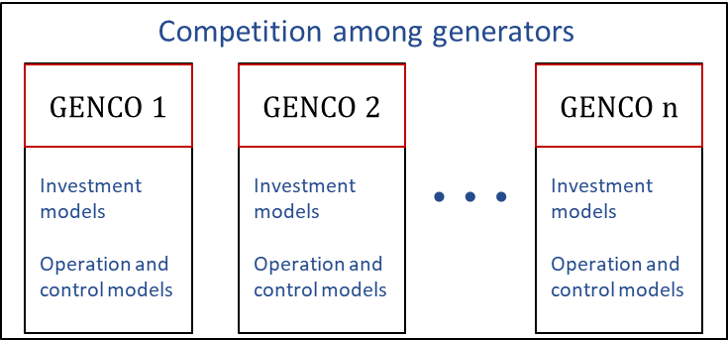
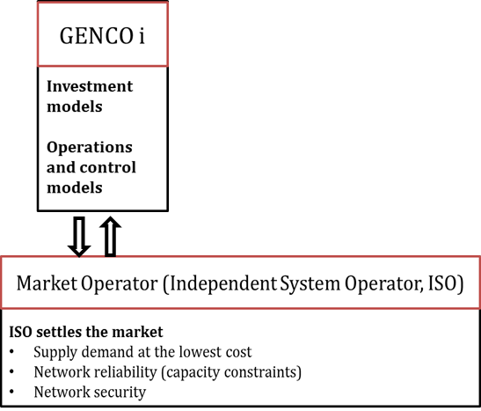
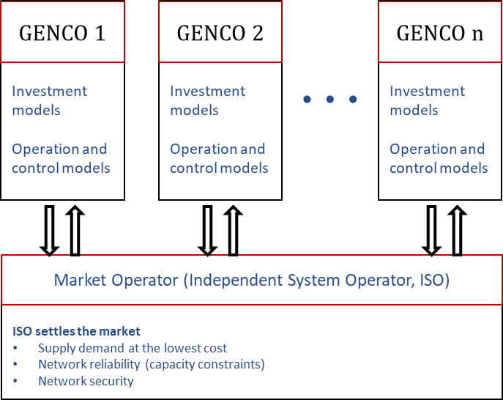

Types of games
Non-cooperative game (symmetric)
“Nash equilibrium”: No player believes it can do better by an unilateral move.
Non-cooperative game
Asymmetric (leader-follower) game
“Stackelberg Equilibrium”, MPEC game
Bi-level optimization problem
Non-cooperative game
Multiple player competing “a la Nash”
Asymmetric game: Multiple leaders, single-multiple follower
“Stackelberg Equilibrium” + “Nash equilibrium”
EPEC game

Slide 5
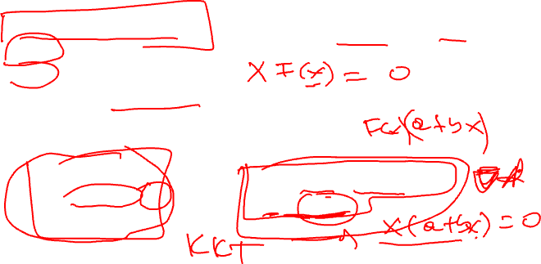
Equilibrium Problems Expressed as Complementarity Problems
Complemetarity Problem (CP): Given a function F: R^{n} → R^{n}, find x ϵ R^{n}, s.t.
An optimization (minimization) problem as a CP

Slide 6
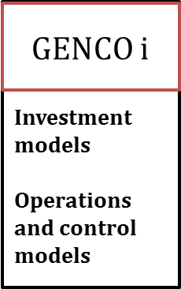
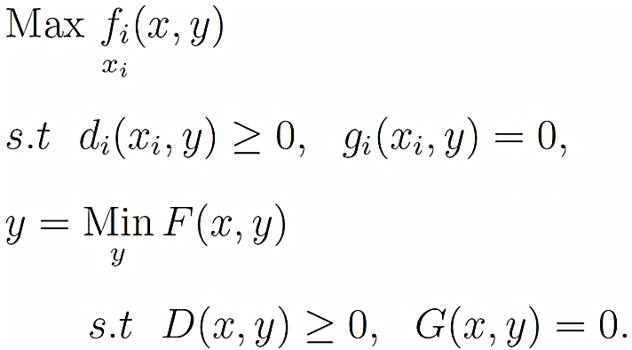
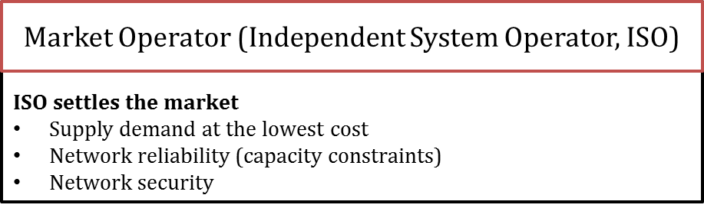
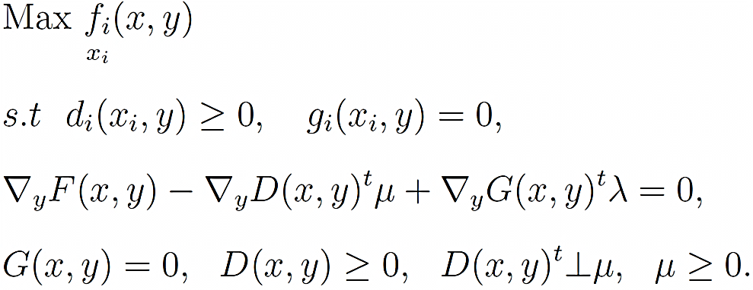
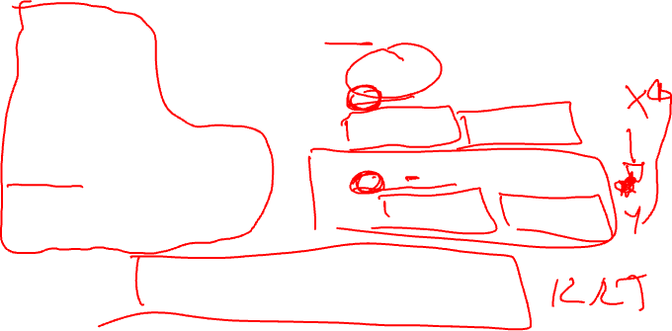
Multiple leader-follower game
Bi-level model for GENCO i

Slide 7
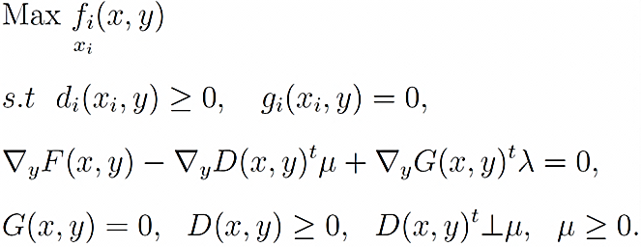

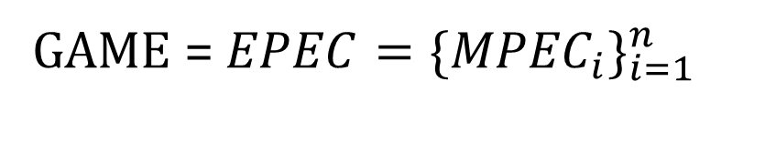
Multiple leader-follower game
Bi-level model:
MPEC model:
GENCO 1: MPEC 1
GENCO n: MPEC n
…
GAME = ${EPEC=\{{MPEC}_{i}\}}_{i=1}^{n}$

Slide 8
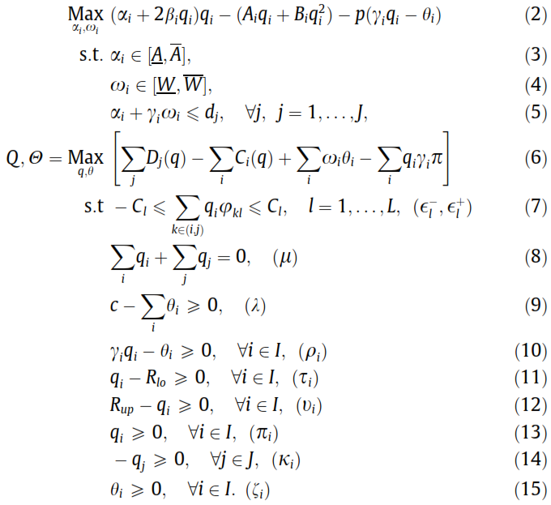

Case study 1) Multiple leader-follower game: Electricity markets under CO₂ policies
Solution approach:
Iteration/Diagonalization/Alternate-Play/Gauss-Seidel approach
Simulate player reactions to each other until no player wants to change their decisions.
Each player’s problem is formulated as an MPEC problem
Diagonalization + Regularization method for complementarity conditions

Slide 9
Case study 1) Multiple leader-follower game: Electricity markets under CO₂ policies

Slide 10
Case study 2 Cooperative leader-follower game: Micro-grids in Electricity networks

Slide 11
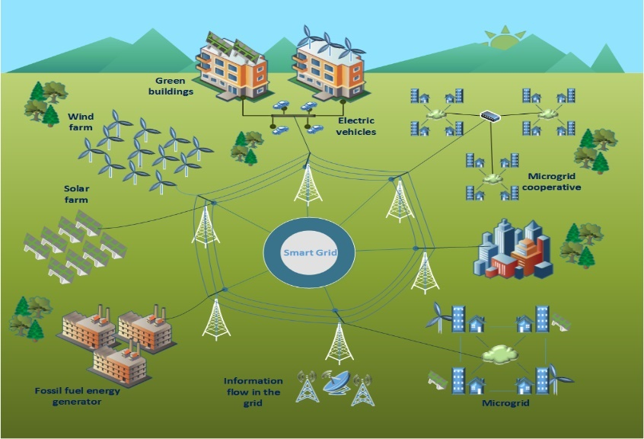
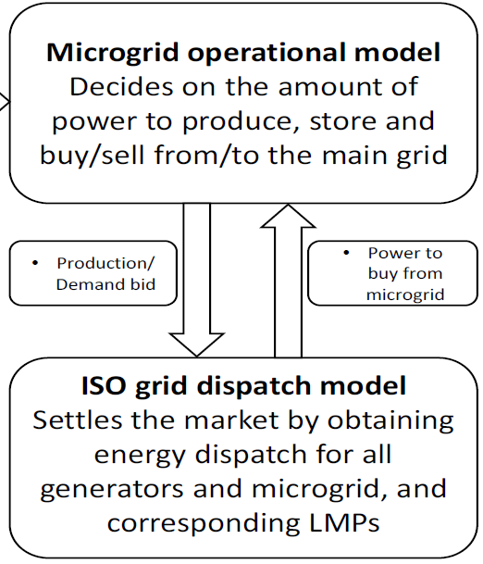
Case study 2) Cooperative leader-follower game

Slide 12
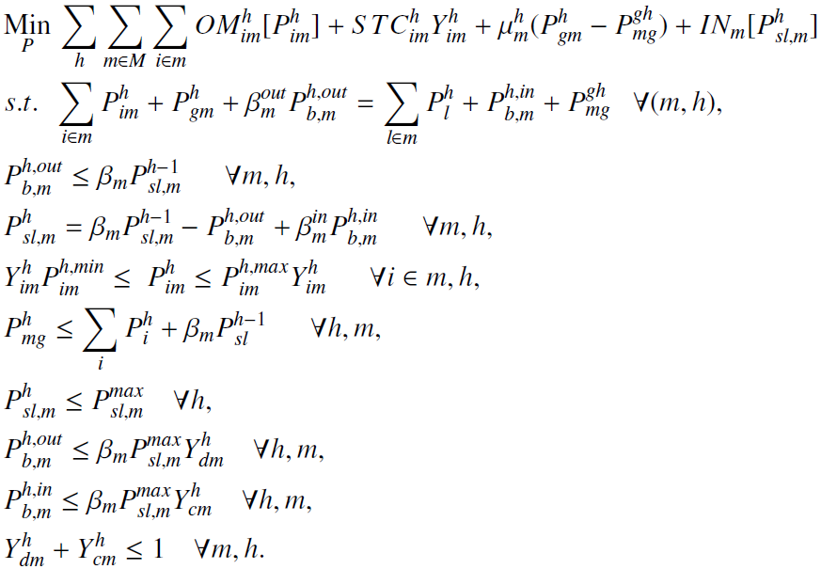
Upper Level: Micro-grid Operational Model
Operation/Emissions cost
Power balance in the micro-grid
Power available in batteries
Electricity stored at end of period h.
Min-Max production limits
Power available to sell to the grid
Max electricity storage level
Battery discharge limit
Battery charge limit
Charge or discharge batteries

Slide 13
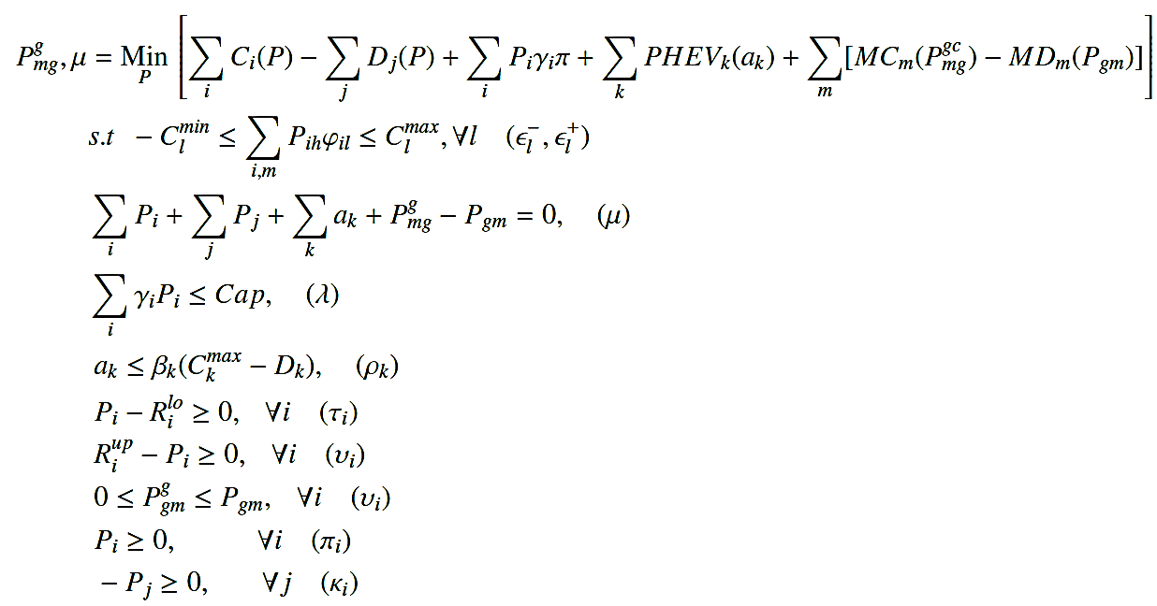
Lower Level: ISO optimization problem
Social/Emissions cost
Thermal capacity of the lines
Power balance in the network
Emissions CAP
PHEVs power
Min-Max production
Power available from microgrids
Positive/negative variables

Slide 14
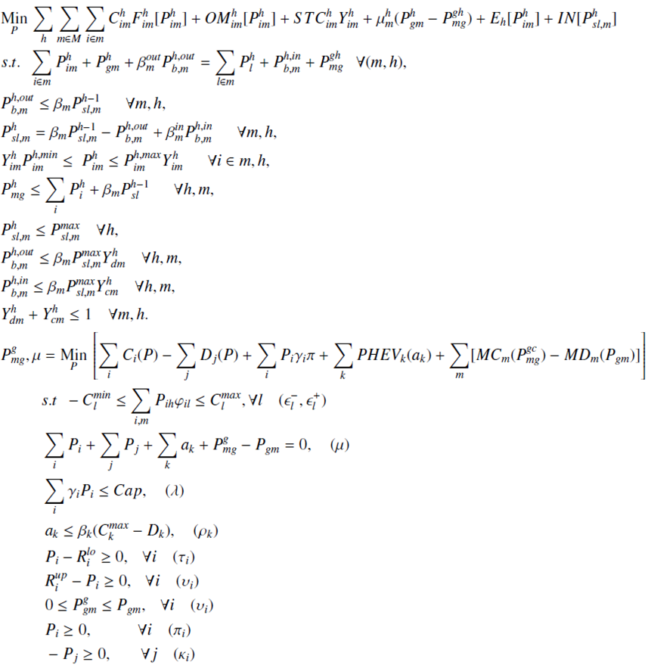
Microgrid – ISO Bilevel problem
Solution approach:
Single leader-follower game
Bi-level problem can be re-formulated as an MPEC
MPEC: Single – level optimization problem
Upper level is a MIP formulation
Linearization of the complementarity conditions
Resulting model is a single level MIP formulation.

Slide 15
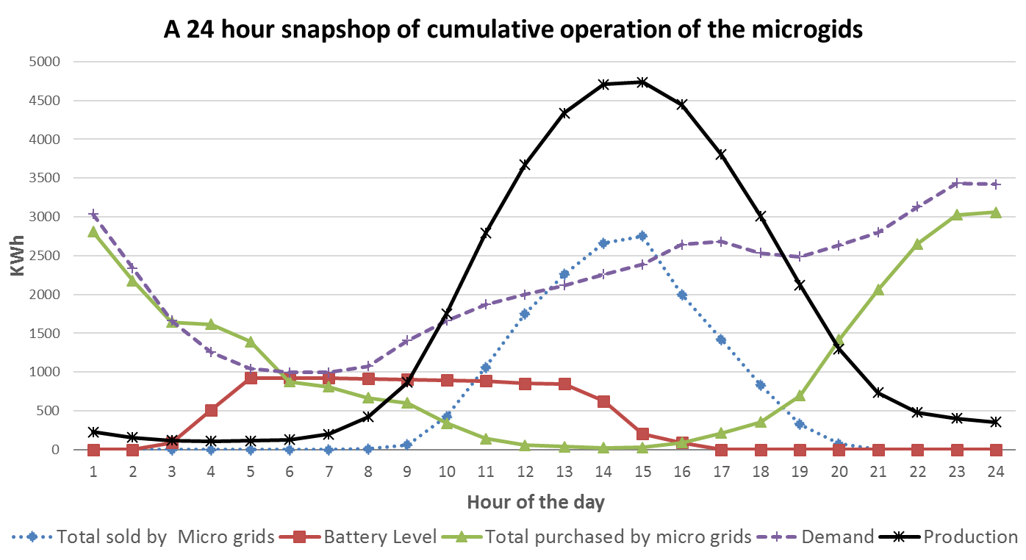
Microgrid – ISO Bilevel problem
Emissions control vial carbon policies and microgrid generation: A bilevel model and Pareto analysis. Felipe Feijoo, Tapas K. Das. Energy, Applied Energy, Volume 119, April-15, Pages 371-383.

Slide 16

Agenda
Introducción a mercados energéticos y su modelación
MPEC – EPEC games
Ejemplos (mercados de electricidad y Smart-grids)
Mathematical Mix Complementarity Problems (MCP)
North American Natural Gas Model
Impact of Price caps in the Chinese Natural gas market
Formulation and case study

Slide 17
MCP for energy market modeling: Natural Gas Markets

Slide 18
Supply chain illustration in a two-node, four-fuel setup
Country A
Country B
Production
Service providers
Demand sectors
Supplier A
Supplier B
Natural gas
Crude oil
Biofuels
Nuclear
Pipeline
Refinery
Ship
Power generation
Storage
Power generation
Ship
Storage
Refinery
Residential & Transport
Industry
Industry
Residential & Transport

Slide 19
MCP for energy market modeling: Natural Gas Markets
Players in the model (profit maximization)
Production (upstream)
Suppliers of fuels (shale and non-shale)
Service providers & infrastructure operators (midstream)
Arc operators (pipeline, ship, rail, LNG, etc.)
Storage operators (gas storage, pump-hydro storage)
Consumption (downstream)
Final demand sectors (by sector)
The policy dimension
Emission permit auctioneer
Government regulations (e.g., biofuel mandates, technology portfolio standards)

Slide 20
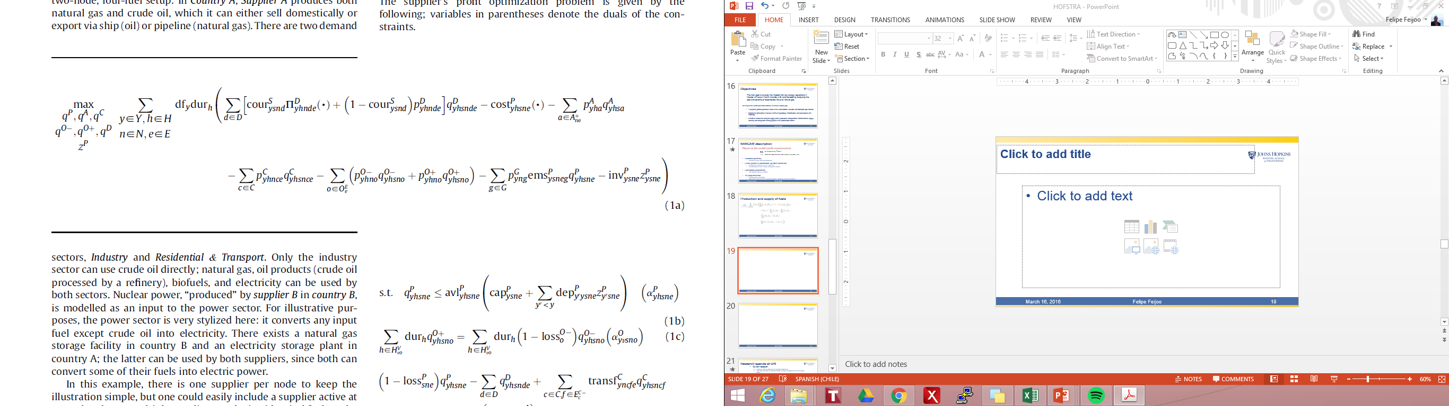
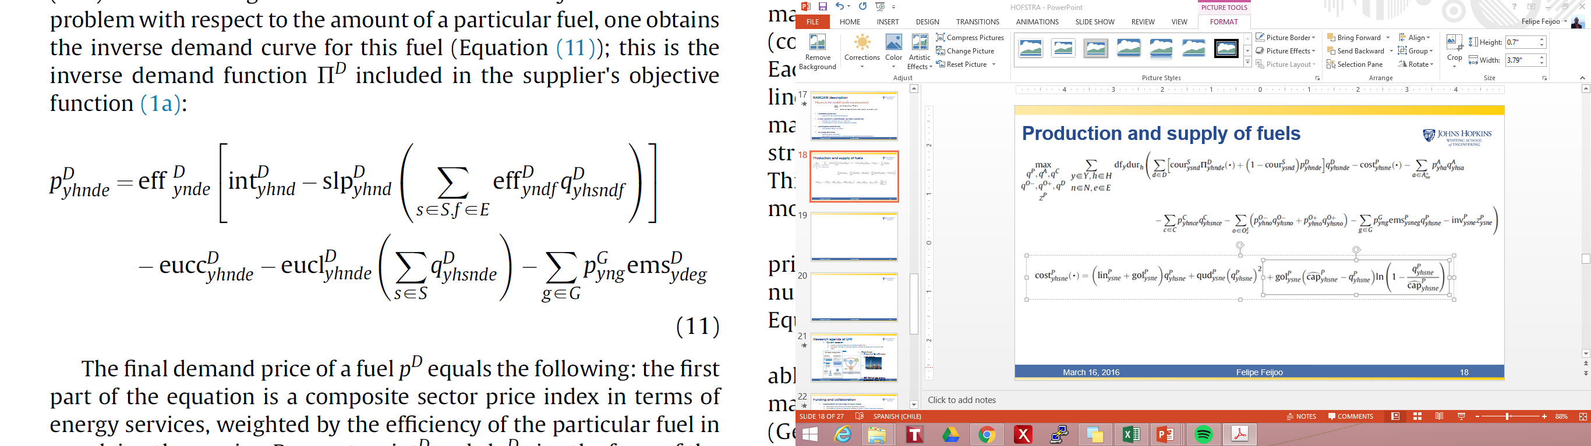
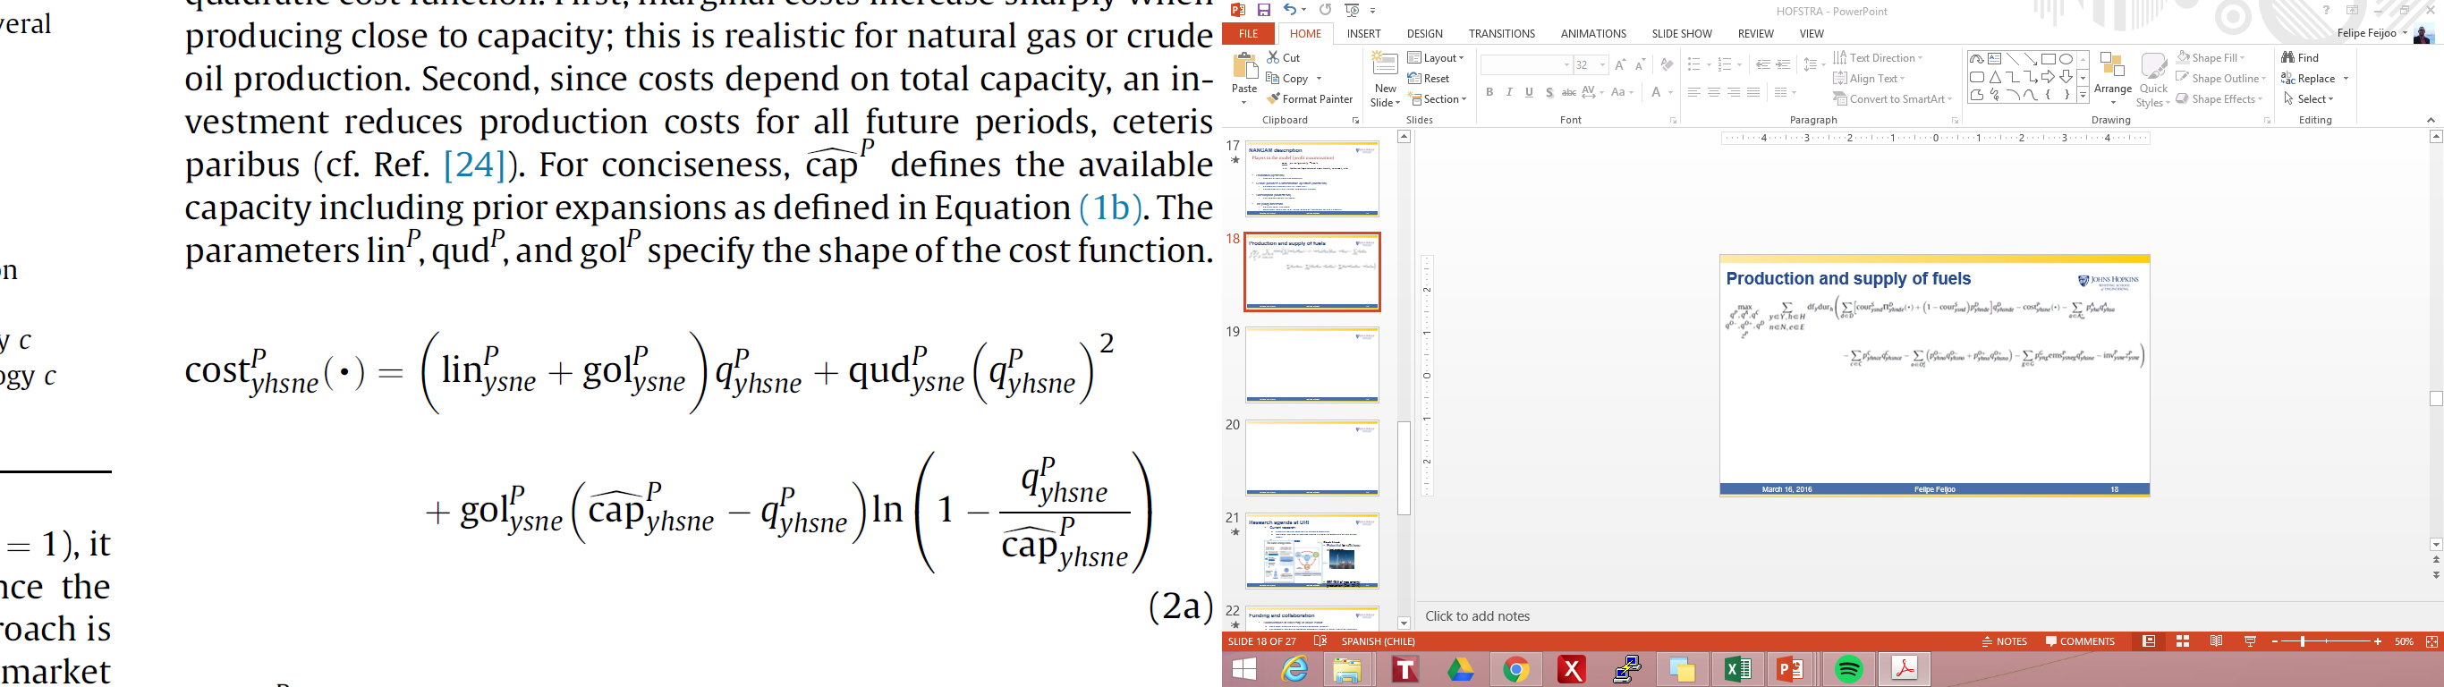
Natural Gas Markets: Supplier’s problem
Cournot market power vs a perfect competitive market (price-takers)

Slide 21
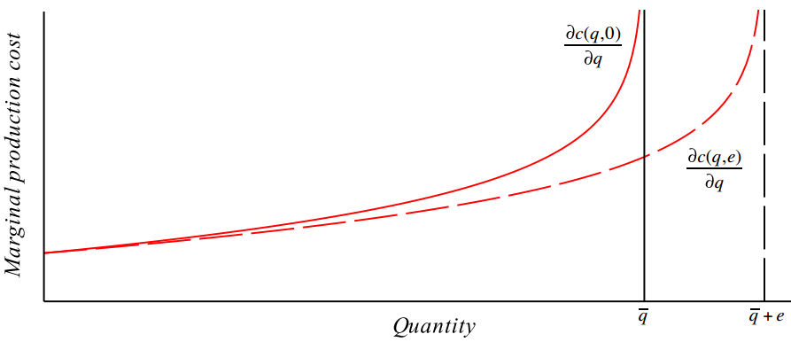
Natural Gas Markets: Supplier’s problem

Slide 22
Natural Gas Markets: Supplier’s problem
Constraints:
Production capacity constraints (capacity, availability factor, depreciation factor)
Mass balance constraint for storage (extracted equals injected while considering losses)
Nodal mass balance constraint (production, sales, transformation to other fuels, exports, imports, injection and extraction must be balanced at each node)
Maximum capacity expansion level (expansion is endogenous)
Reserve horizon (maximum cumulative production over horizon)

Slide 23
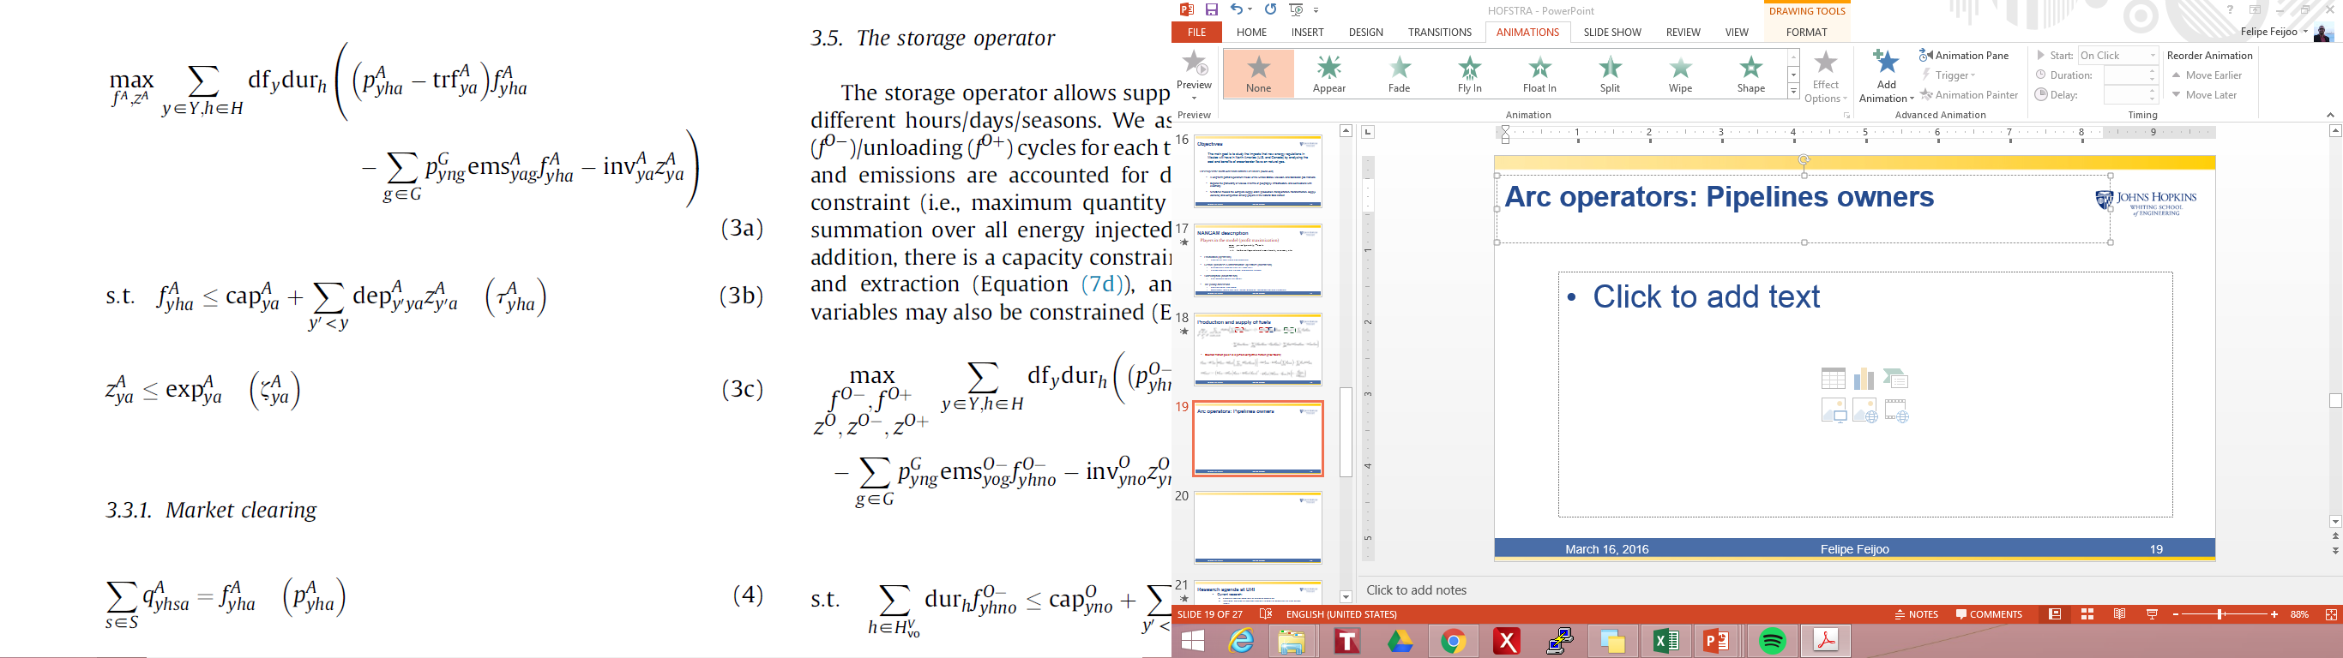
Midstream players: Pipeline operators
Maximizes profit from transporting fuel (gas) considering operation and emissions const.
Endogenous capacity investment decisions

Slide 24
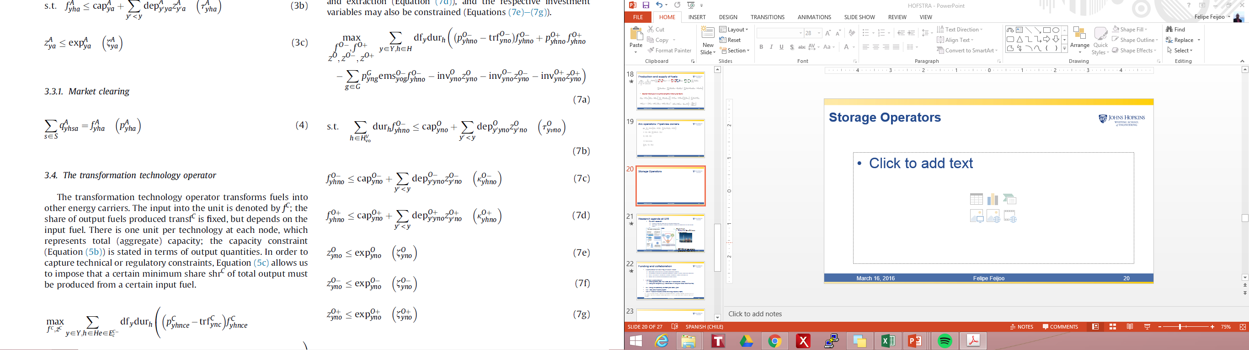
Midstream players: Storage operators
The storage operator allows suppliers to transfer fuels between different hours/days/seasons.
All cost, losses, and emissions are accounted for during injection
Capacity investment is endogenous (maximum storage capacity)

Slide 25
MCP for energy market modeling: Natural Gas Markets – Solution Approach
Approach 1 – an optimization problem
Assume a benevolent planner optimizing the entire energy system
Approach 2 – an equilibrium model
Assume a number of players competing in a market
Each player faces a constrained optimization problem
Coupled with market clearing constraints
Can be solved by deriving first-order optimality (KKT) conditions

Slide 26
MCP for energy market modeling: Natural Gas Markets – Solution Approach
Approach 2 – an equilibrium model
Under certain conditions, the KKT point(s) and the solution (sets) to Problem (1) are identical (“constraint qualifications”)

Slide 27
MCP for energy market modeling: Natural Gas Markets – Solution Approach
Approach 2 – an equilibrium model
FOC (KKT) for each player (suppliers, pipeline operators, storage operators, demand sectors) + Market clearing constraints
Mixed Complementarity Problem can be solved using standard numerical methods
e.g., PATH solver in GAMS (Ferris and Munson, 2000)
The equilibrium (in general) depends on the behavioural assumption regarding the players (market power, knowledge)

Slide 28
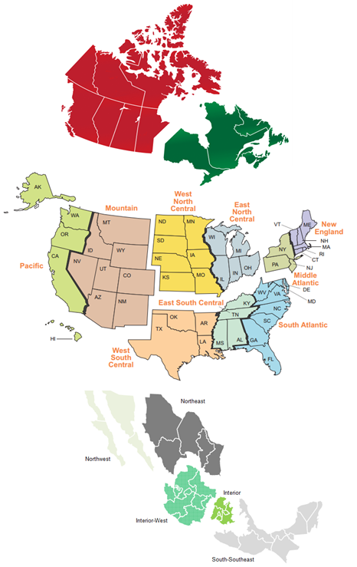
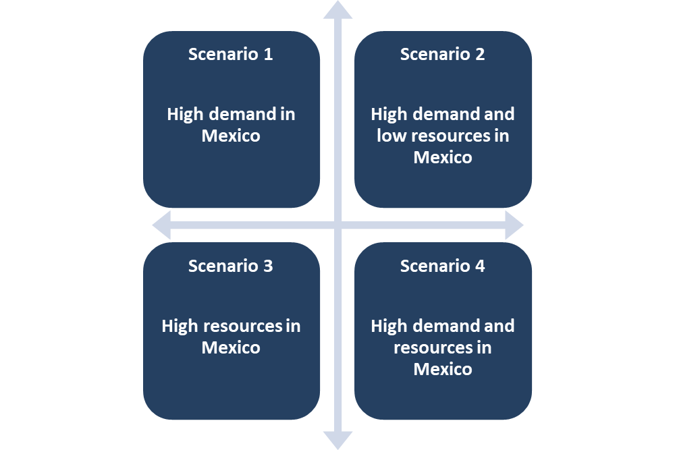
MCP for energy market modeling: Natural Gas Markets
The North American Natural Gas Model (NANGAM)
A long-term partial-equilibrium model of the United States, Mexican, and Canadian gas markets.
NANGAM models the complete supply chain (production, transportation, transformation, supply, demand) and competition among players in the Natural Gas Market

Slide 29
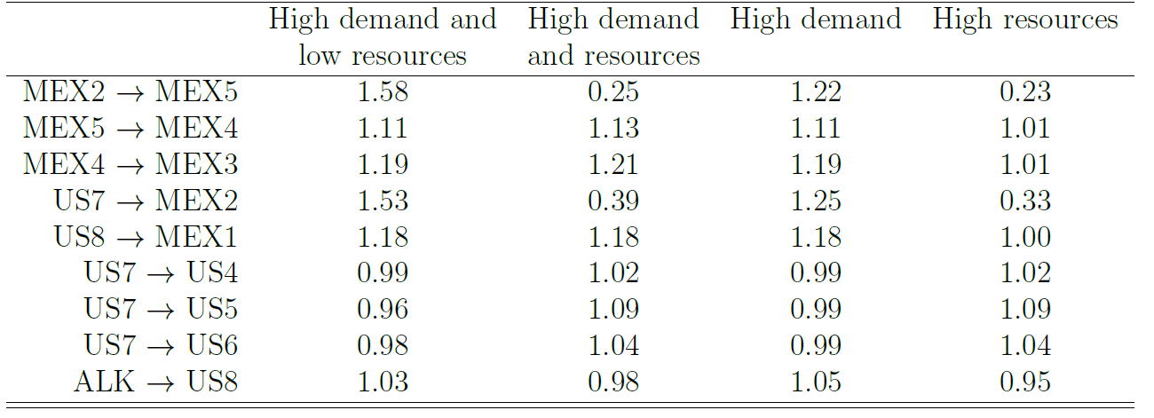
MCP for energy market modeling: Natural Gas Markets
Flows from ALK to New Mexico-Arizona (US8) increase when there are low resources in Mexico (needed to meet increasing demand in Mexico)
Flows from Texas (US7) to Monterrey (Mex2) increase by ~50%, but flows from Texas to connected nodes is reduced (~7%). Therefore, production increases in those nodes to satisfy demand.
Production levels:
High demand and low resources
Flows compared to base scenario
 | 2010 | 2015 | 2020 | 2025 | 2030 | 2035 | 2040
ALK | 1.00 | 1.00 | 1.01 | 1.02 | 1.04 | 1.04 | 1.04
CAE | 1.00 | 1.00 | 1.00 | 1.00 | 1.01 | 0.99 | 1.00
CAW | 1.00 | 1.01 | 1.00 | 1.00 | 1.01 | 1.00 | 1.00
US2 | 1.00 | 1.02 | 1.01 | 1.00 | 1.00 | 1.00 | 1.00
US3 | 1.00 | 1.00 | 1.00 | 1.00 | 1.01 | 1.01 | 1.01
US4 | 1.00 | 1.01 | 1.02 | 1.02 | 1.03 | 1.02 | 1.03
US5 | 1.00 | 1.01 | 1.05 | 1.07 | 1.08 | 1.07 | 1.09
US6 | 1.00 | 1.01 | 1.06 | 1.07 | 1.09 | 1.08 | 1.10
US7 | 1.00 | 1.01 | 1.05 | 1.07 | 1.08 | 1.11 | 1.11
US8 | 1.00 | 1.01 | 1.01 | 1.01 | 1.01 | 1.01 | 1.01
US9 | 1.00 | 1.00 | 1.01 | 1.02 | 1.01 | 1.01 | 1.01
MEX2 | 1.00 | 0.83 | 0.87 | 0.82 | 0.78 | 0.71 | 0.75
MEX5 | 1.00 | 0.82 | 0.65 | 0.61 | 0.54 | 0.45 | 0.49

Slide 30
Agenda
Introducción a mercados energéticos y su modelación
MPEC – EPEC games
Ejemplos (mercados de electricidad y Smart-grids)
Mathematical Mix Complementarity Problems (MCP)
North American Natural Gas Model
Impact of Price caps in the Chinese Natural gas market
Formulation and case study

Slide 31
Case Study: Chinese Natural Gas market model – Impact of price caps

Slide 32
Impact of Price caps in the Chinese Natural gas market
Despite significant progress made by China in liberalizing its natural gas market, certain key areas such as market access and pricing mechanisms remain heavily controlled by the government.
Natural gas production in China has grown rapidly in the 21st century increasing over 500 % from 27.2 bcm in 2000 to 136.9 bcm in 2016.
Yet, the growth in demand has outpaced supply growth, increasing about 850 % over the same period.
The gap between supply and demand has been filled by imports which totaled 74.6 bcm in 2016 or 36% of total consumption. This gap has been projected to continue increasing, reaching 210 bcm by 2020 and 807 bcm in 2050
The Energy Information Administration (EIA) indicates that China has the largest shale gas reserves in the world, almost twice as large as those of the United States. These reserves represent almost 20% of the reserves in the world, and about 92% in Asia.

Slide 33
Impact of Price caps in the Chinese Natural gas market
Problems that have led to a recent slowdown in production growth and impeded further development of the sector (Shell and DRC 2017, Li 2015, Wang and Li 2014) :
low efficiency,
opaque and complex pricing mechanisms,
problematic transportation and
organizational inflexibility
Ambitious targets set by Chinese policy makers for the natural gas industry:
10% of total energy consumption by 2020,
15% by 2030, and
increasing annual demand to 360 bcm by 2020 (NDRC 2016, 2017)
NOT BY IMPORTS ALONE!

Slide 34
Impact of Price caps in the Chinese Natural gas market
Energy Reform and pricing policy:
third party access to infrastructure
unconventional gas and LNG imports have been largely liberalized
certain consumer groups (commercial and residential demand, small industrial users) are still subject to fixed prices or price caps for pipeline deliveries
These price distortions incentivize profit maximizing firms to avoid supplying gas at capped prices by altering their operational, logistic and investment strategies, and lead to cross-subsidization of lower-priced regulated demand sectors with higher tariffs charged at deregulated markets.
Limited access to midstream infrastructure further distorts logistics patterns and leads to suboptimal market structure and less efficient resource allocation on the national scale (Xu et al. 2017 and Song et al. 2015).

Slide 35
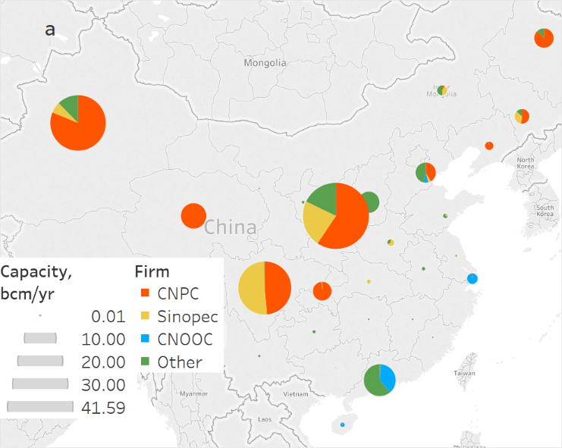
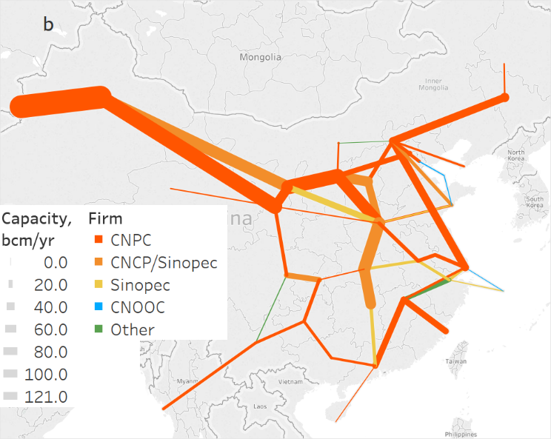
Impact of Price caps in the Chinese Natural gas market
A single-period equilibrium model that provides a short-term perspective on China’s gas market.
The model is formulated as a MCP and represents the profit-maximizing behavior of price-taking suppliers – three large NOCs and smaller fringe suppliers – with some market segments (chemical and City Gate pipeline deliveries) subject to price caps. The NOCs own most of midstream infrastructure.
Sources: IHS, Ministry of Land and Resources of China, KAPSARC research.

Slide 36
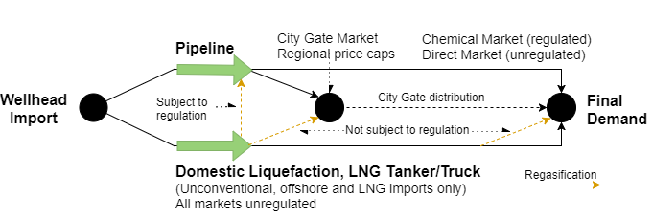
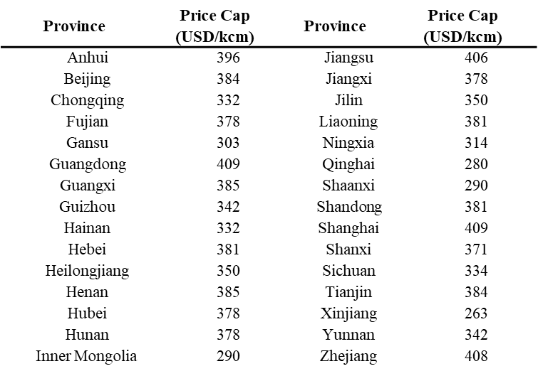
Impact of Price caps in the Chinese Natural gas market
Table 1. Provincial City Gate Price Caps

Slide 37
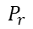
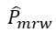
Impact of Price caps in the Chinese Natural gas market
Mathematical formulation: Regulated market conditions
Z_{mrw} : Potential lost revenue for a cubic meter of gas for suppliers if they deliver gas at a price cap below the market price. is the price in region r and is the capped price.
$$P_{r}$$
$${\hat{P}}_{mrw}$$
δ_{mrw} : Representing government enforced delivery obligations when the price cap is binding for a given type of gas (pipeline or LNG)
DL_{mrw} : Demand level enforced by the government (quota) to the NOCs or gas suppliers

Slide 38
Mathematical formulation

Slide 39
Optimality conditions

Slide 40
Data for China´s gas sector
Table 1. Provincial City Gate Price Caps
Table 2. Regional demand

Slide 41
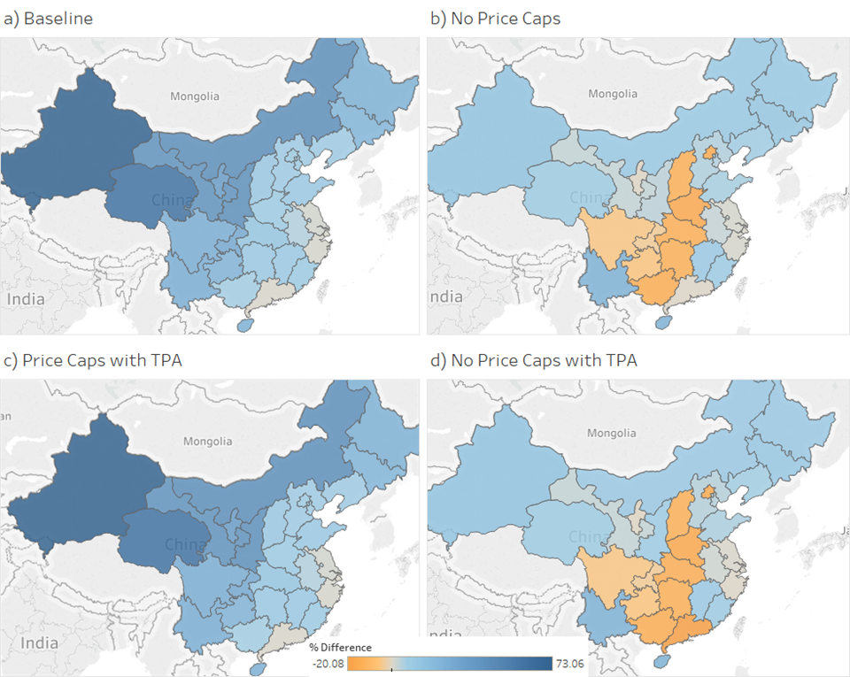
Results
Difference between Marginal Cost and City Gate Price Caps
On average across all provinces, the difference exceeds the caps by 17% in the Baseline.
On average spot prices (marginal supply costs) decrease when lifting the price caps, by 14% from 419 USD/kcm (10.6 USD/mmbtu) to 357 USD/kcm (9.7 USD/mmbtu)
Total systems costs are reduced by 4.7%, or 1.4 billion USD.
Price Caps with TPA scenario we observe a significant decline (36%) in LNG imports
No Price Caps with TPA – the overall economic gain increases to 7.6%, or 2.2 billion USD. We see a further shift from LNG to central Asian pipeline imports, and a large drop in domestic liquefaction and LNG shipments.

Slide 42
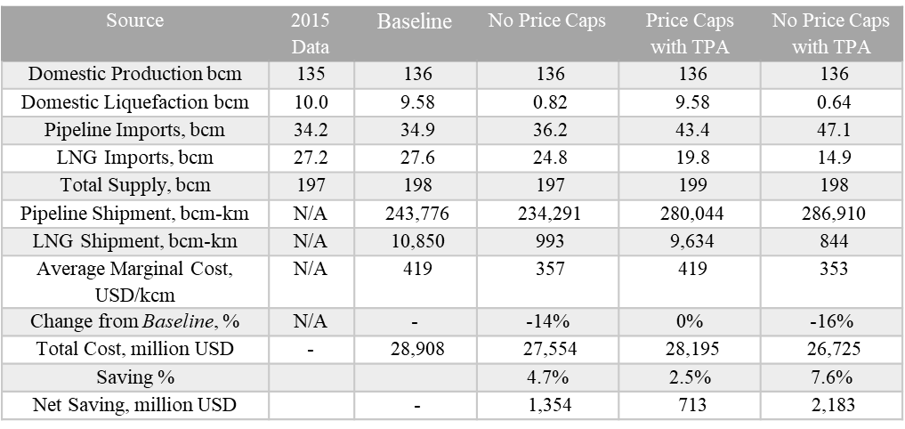
Results
Table 3. Production, Imports, Marginal Supply and Total Costs for the Modeling Scenarios.

Slide 43
Summary of results
Lifting the price caps for regulated natural gas demand sectors could yield a:
4.7% reduction in total system cost and
Reduce the national average marginal supply cost by 16%.
Liberalized prices combined with improved third party access to pipeline and regasification infrastructure would result in:
2.2 billion USD costs saved (7.6%) and
16% reduction in the spot price, due to replacing domestic and imported LNG with pipeline distribution.
The LNG industry – consisting of both imports and domestic liquefaction combined with trucking – would be negatively affected by the reforms investigated in this study, as market players would gain more flexibility in their logistics and would utilize lower cost supply pathways.

Slide 44
Thank you, any questions? Felipe Feijoo, Ph.D. felipe.feijoo@pucv.cl felipefeijoo.weebly.com

Slide 45
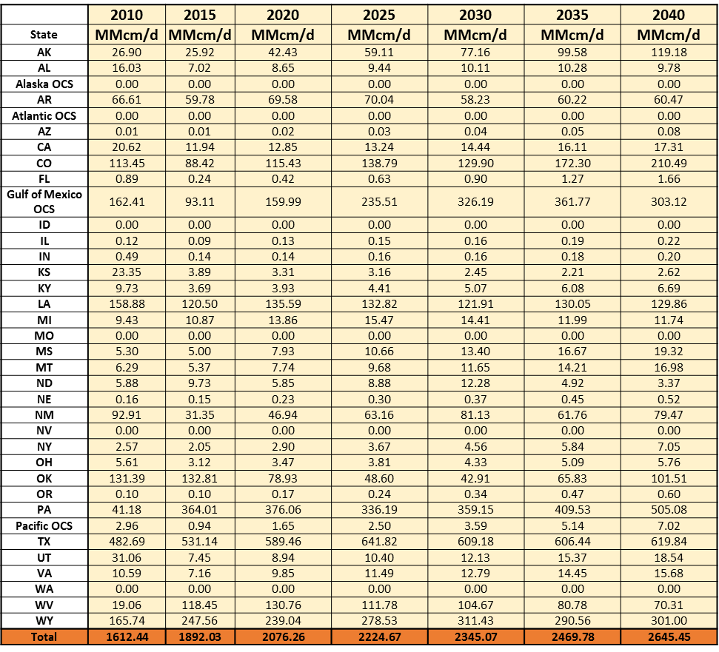
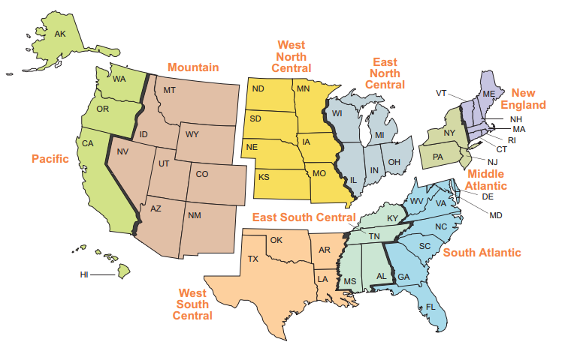
Methodology: GCAM-USA
coalbed methane
conventional gas
shale gas
tight gas
unconventional gas other

Slide 46
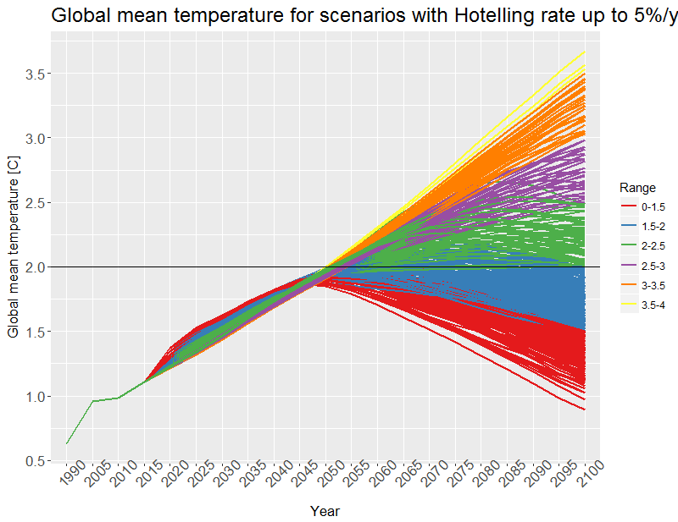
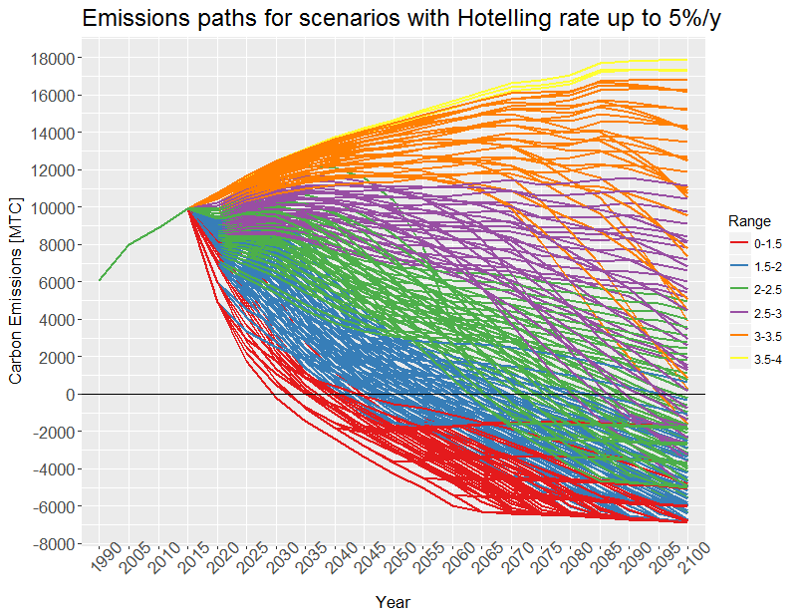
General Results
1.5ºC scenarios allow slightly higher temperatures before mid-century
However, temperature levels spread after mid-century. All temperature paths approach to 2ºC by 2050. Strategies taken before mid-century (in the energy-land systems) are realized after mid-century.
Scenarios show at least a global mean temperature of ~1.8ºC by mid-century, independently of the actions that are taken.
Opposite to the 2ºC goal, 1.5ºC is not achievable without overshoot.

Slide 47


2) A Natural Gas Model for North America: Impact of Cross-border Flows of Natural Gas with Mexico
North American Natural Gas Model: Impact of cross-border trade with Mexico. Felipe Feijoo, Daniel Huppmann, and Sauleh Siddiqui. Energy. 2016. Volume 112, 1 October 2016, Pages 1084-1095. DOI: 10.1016/j.energy.2016.06.133.

Slide 48
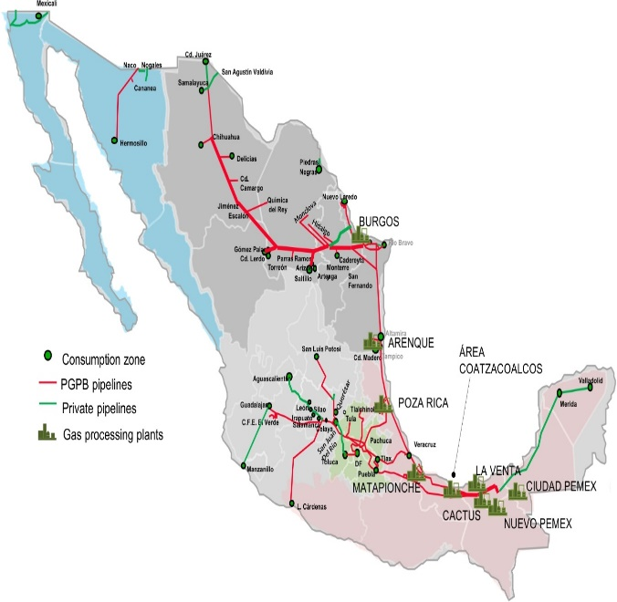
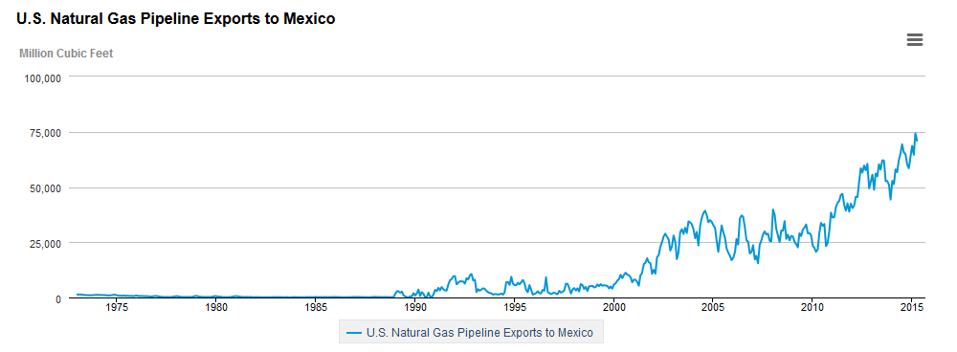
Background about Mexico
Mexico is the United States’ second largest export of natural gas after Canada. Natural gas demand grew 60% in Mexico between 2008 and 2013.
The Mexican government promulgated the Energy Reform, which was implemented on August 11, 2014.
Induced gas production in the U.S. to satisfy Mexico’s demand growth may become an environmental issue in the future.
AZ, NM
US8
TX
US7
Source: http://www.eia.gov/naturalgas/weekly/archive/2015/10_22/index.cfm#itn-tabs-2

Slide 49
The current data set: base scenario
Production and demand for the U.S.
U.S. Energy Information Administration EIA, Natural Gas Gross Withdrawals and Production (Dry Production), Natural Gas Prices, Pipeline projects.
Annual Energy Outlook 2015
Production and demand for Canada.
National Energy Board, NEB Canada's Energy Future 2013: Supply and Demand Projections to 2035
Production and demand for Mexico.
Secretaría de Energía SENER, Prospectiva de Gas Natural y Gas L.P.
U.S. Energy Information Administration EIA
Gas y Petroquímica Básica Pemex, Condiciones Generales para la Prestación del Servicio de Transporte de Gas Natural

Slide 50
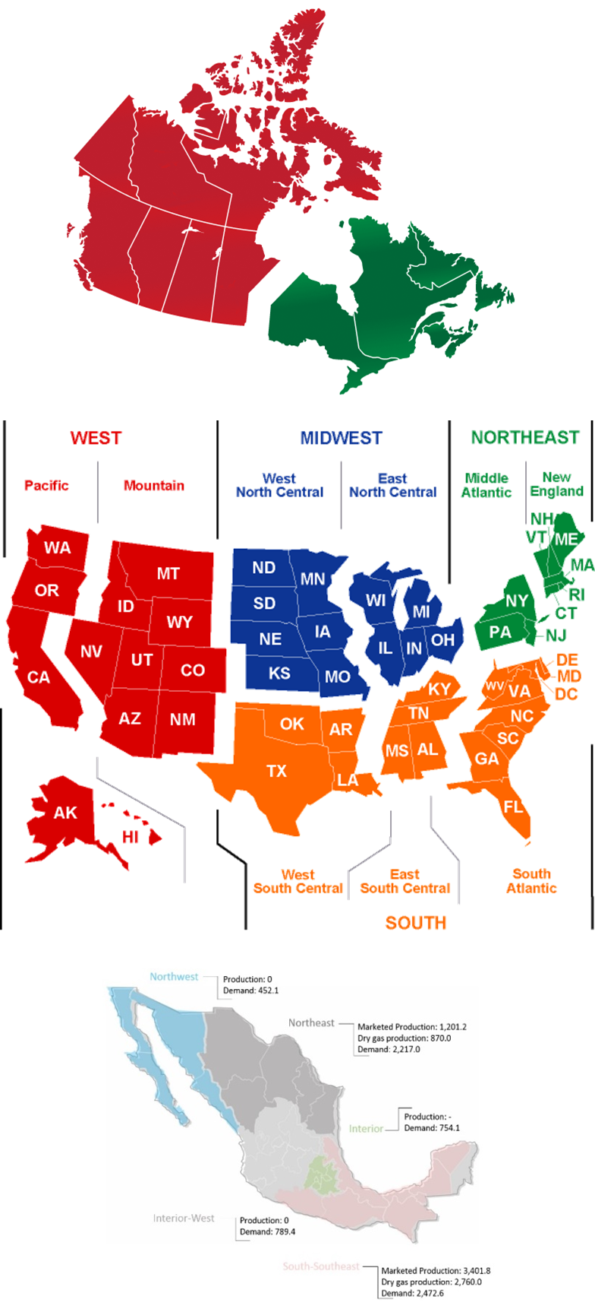
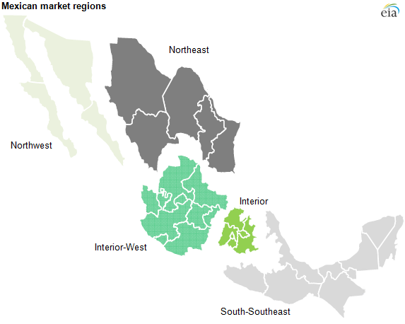
Results: Texas main supplier
High demand in Mexico
Increased flows from Texas, New Mexico and Arizona to Mexico (Monterrey area)
Increased production in Texas (~6% through 2040)
High demand in Mexico and high resources
Less flows from Texas to Mexico
Reduced production in Texas (~12% less in 2040)
17%↑
-61% ↓

Slide 51
Results
The region US7 (Texas mainly) is highly impacted by different scenarios in Mexico, primarily as it is the main exporter. (endogenous)

Slide 52
3) Infrastructure development and utilization in the North American natural gas market.
Felipe Feijooª, Gokul Iyerª, Pralit Patelª, Marshall Wiseª, Leon Clarkeª, Sriram Sankaranarayanan^{b} , Sauleh Siddiqui^{b}
ª Pacific Northwest National Laboratory – Joint Global Center Research Institute
^{b} Department of Civil Engineering, Johns Hopkins University.
To be submitted to Nature Energy.

Slide 53
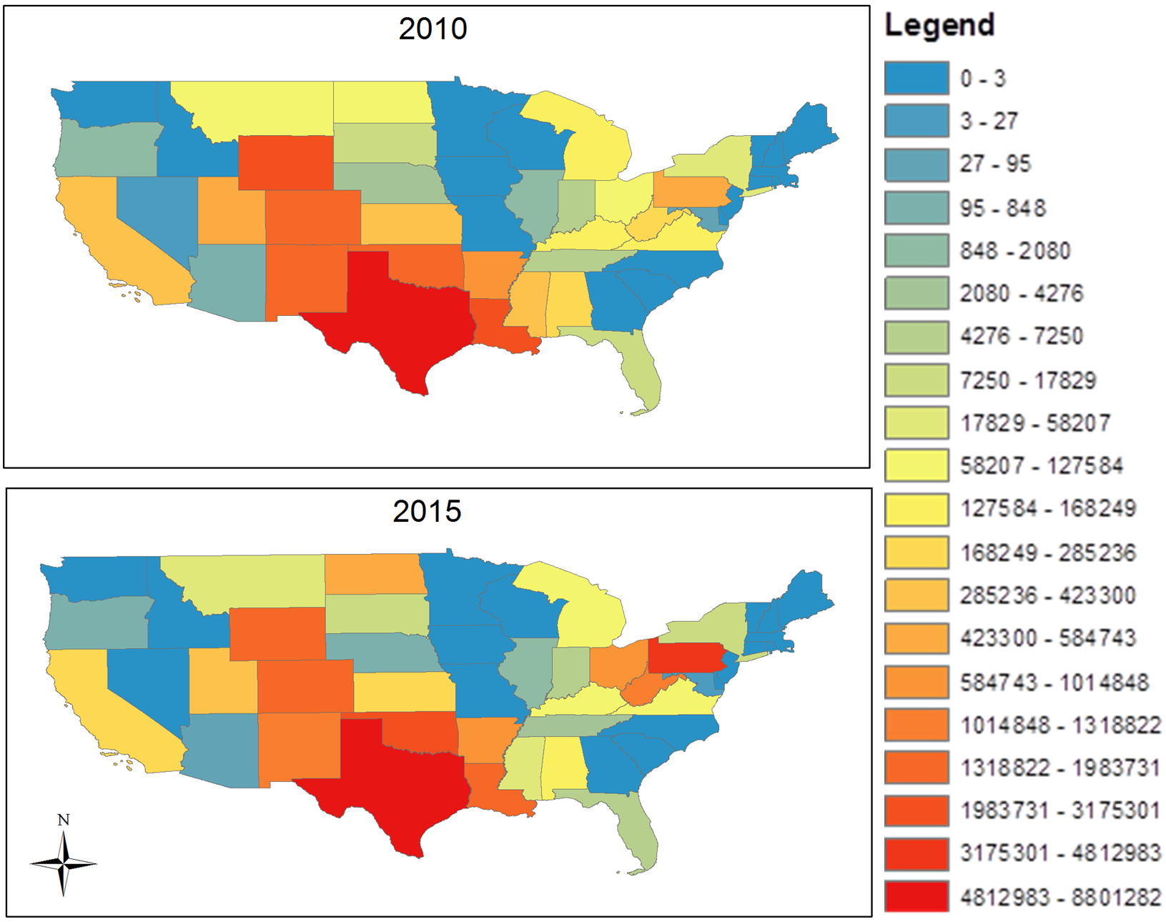
Introduction
Natural gas gained significant attention due to its low carbon emissions and competitive prices in North America relative to other energy sources.
New energy policies and environments
Mexico energy reform
Clean power plan (target by state)
80% reduction on carbon emissions
Paris agreement
Volatility of international oil price
These rapid changes are likely to change the natural gas sector in the U.S. and worldwide
How all these changes will play together?
How do we plan a future infrastructure to account for these changes?

Slide 54
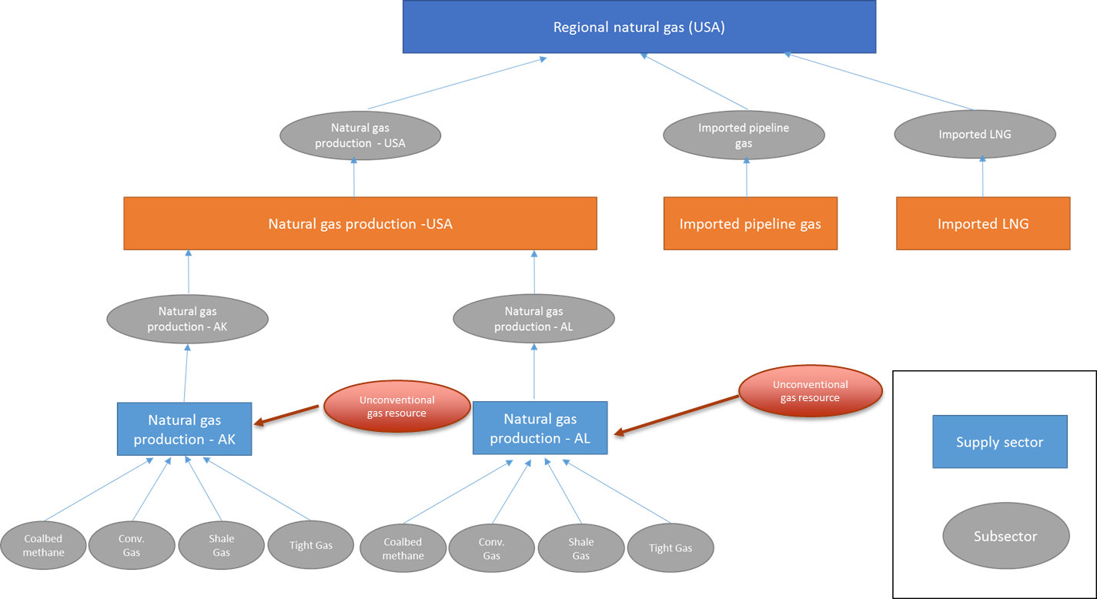
Methodology: GCAM-USA
Details at a state level while also considering global regions (32)
Detailed representations of other primary resources (coal, oil, uranium, bioenergy, hydro, solar and wind).

Slide 55
THE GLOBAL CHANGE ASSESSMENT MODEL (GCAM)

Slide 56
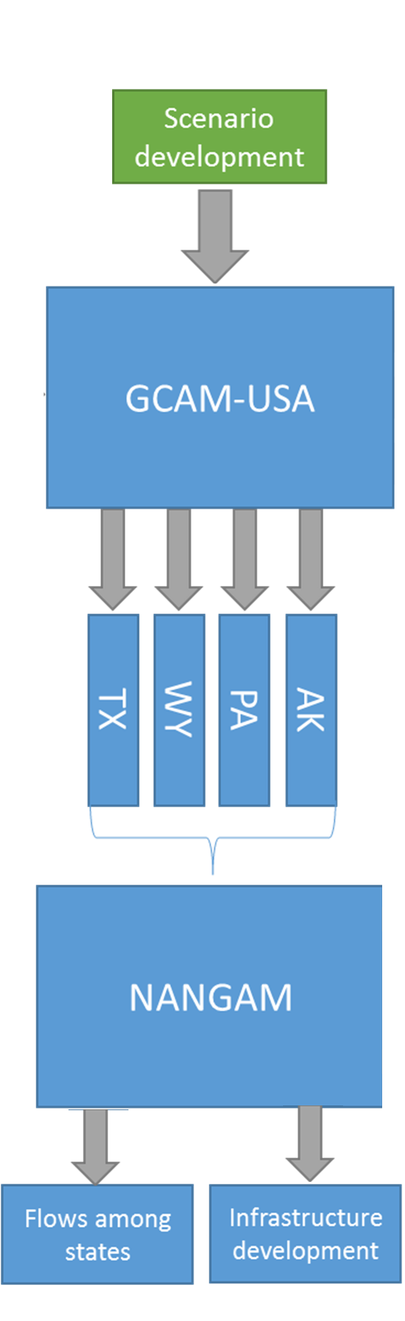
Methodology
To address the abovementioned problem, this work uses the capabilities of two models.
We use the Global Change Assessment Model (GCAM) GCAM-USA to model future paths (for different scenarios) of natural gas production in the U.S. at a state level.
Given the GCAM-USA results, they are used to fit the North American Natural Gas Model (NANGAM). NANGAM has the capability to obtain endogenously infrastructure development (pipelines) over a desire horizon.

Slide 57
Methodology: GCAM-USA
coalbed methane
conventional gas
shale gas
tight gas
unconventional gas other

Slide 58

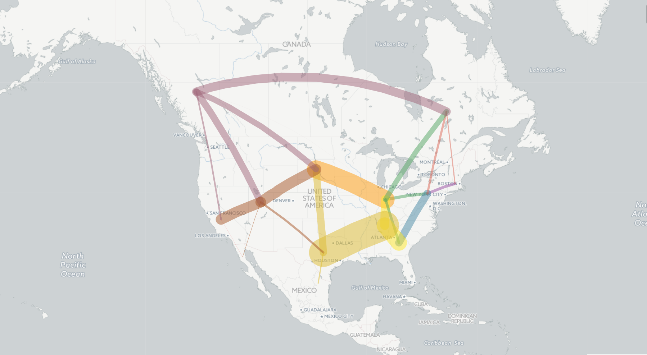
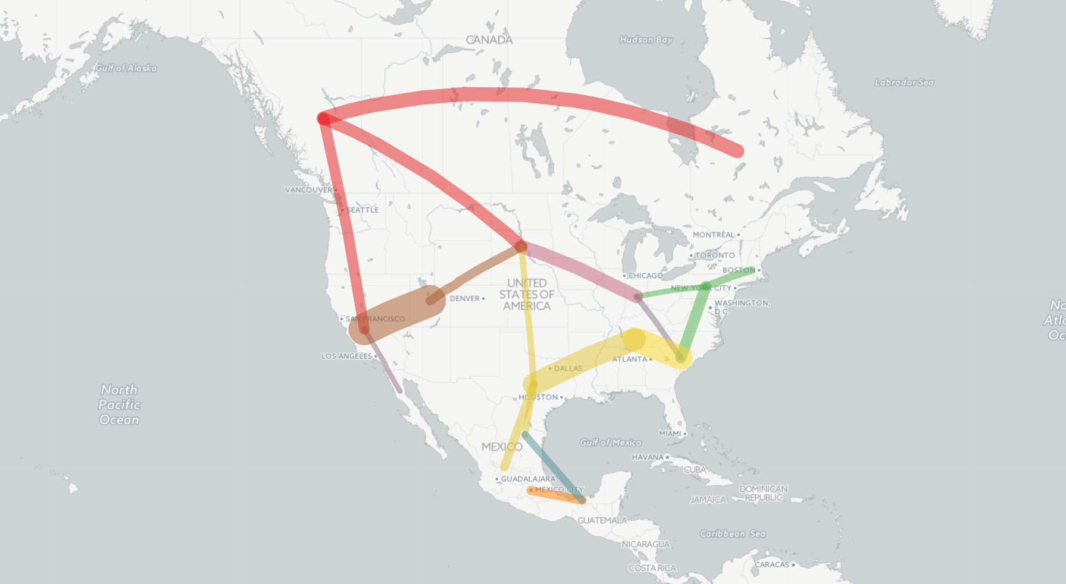

Scenarios: Reference scenario
Major changes in direction of flows
2010: Flows upward to northeast and imports from eastern Canada
2040:
Northeast behaves as a hub.
Less flows upward to northern areas.
Flows redirected to the West coast and Mexico

Slide 59
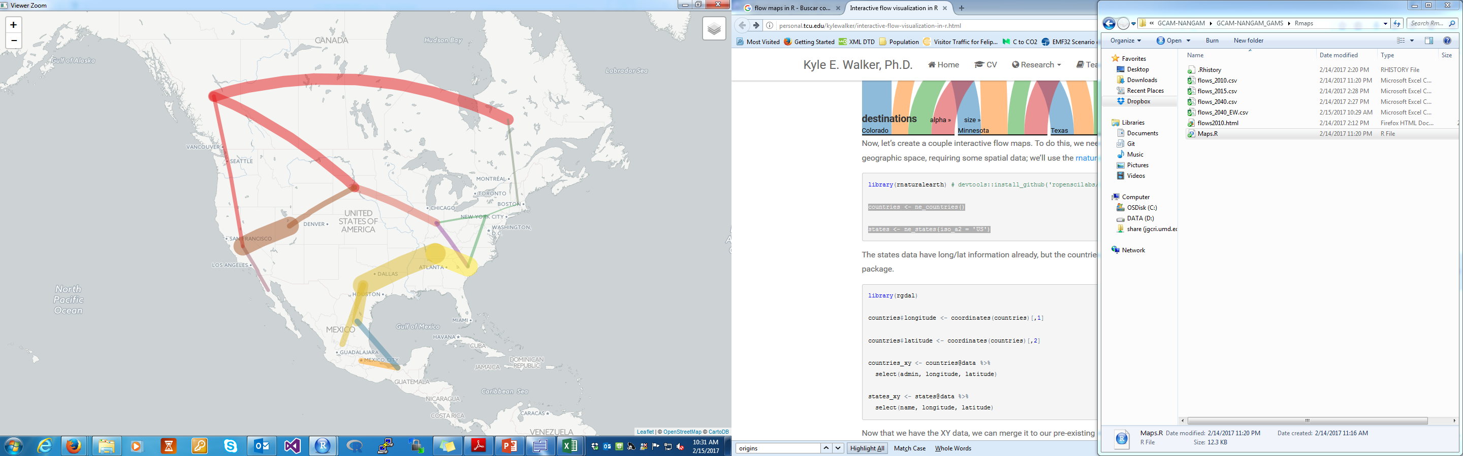
Results: Comparison of flows with Economy Wide carbon cap
Flows within the U.S. are in general reduced.
Emissions scenario: New flows from Eastern Canada to New England area (US1)
Higher exports to Mexico

Slide 60
Flows to Mexico (total) are 36% higher (~71bcm vs ~97 bcm)
Additional pipeline capacity on pipelines to Mexico:
Reference scenario: 14.53 bcm
Emissions scenario: 35.13 bcm
Additional capacity in Mexico: 32.7 bcm (reference) vs 30.82 bcm (policy)
Additional capacity in the U.S.: 28.17 bcm vs 0 bcm
In reference scenario: Pipeline US2-US3 and CAW-US9 are increased

Slide 61
Total outgoing flows from US2 (northeast region)
Reference scenario: 84.9 bcm
Emissions scenario: 28.06 bcm
Total outgoing flows from US7 (west south central, Texas, region)
Reference: 206 bcm
Emissions scenario: 239 bcm -> Increased is driven by higher exports to Mexico.

Slide 62
Trade-offs between carbon prices, price escalation rate and negative emissions to limit climate change to 2ºC and 1.5ºC.
Felipe Feijoo, Jae Edmonds, Leon Clarke, Marshall Wise, Haroon Kheshgi and Bryan Mignone
To be submitted to Nature Climate Change

Slide 63
Research questions and approach
What are the key determinants of emissions pathways that limit climate change to 2 degrees or 1.5?
When must emissions reach zero?
When must emissions peak?
What are the carbon prices and the rate at which they increase needed to limit global warming?
When does the temperature peak happen?
Can we achieve the goals without overshoot?
What is the role of negative emissions? Do negative emissions impact the peak/net-zero timing?
This paper present a full-factorial scenario design of carbon prices that result in a global warming of 1.5ºC or 2ºC degree by the end of the century.

Slide 64
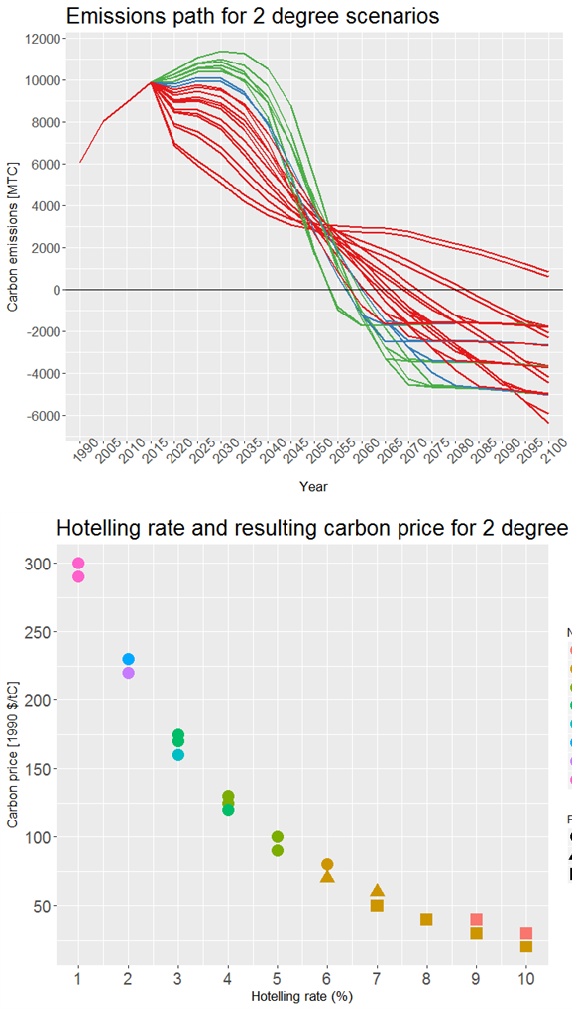


Results: Scenarios for 2 degree C
Emissions peak year: 2015-2030
Net-zero year: 2050-2080
Net emissions ~3000MTC by mid-century
Sufficiently high initial carbon prices at low rate of increase are likely to limit warming to 2ºC with later net-zero timing.
Lower prices need faster increase to limit warming. This results in a later emissions peak year and hence an earlier net-zero year is needed.
Clear trade-off between carbon price and Hotelling rate, where max-level of negative emissions do not seem to create variability.

Slide 65
General Results
1.5ºC scenarios allow slightly higher temperatures before mid-century
However, temperature levels spread after mid-century. All temperature paths approach to 2ºC by 2050. Strategies taken before mid-century (in the energy-land systems) are realized after mid-century.
Scenarios show at least a global mean temperature of ~1.8ºC by mid-century, independently of the actions that are taken.
Opposite to the 2ºC goal, 1.5ºC is not achievable without overshoot.

Slide 66






An economic model: Pricing policies
DRUG RETAILER
Drugs demand
(orphan, prescription, and generic drugs)

Slide 67
Other models compared with NANGAM
Gas Trade Model, Beltramo et al., (1986).
The World Gas Model (WGM) and its variations, Gabriel et al. (2005).
Global Gas Model, Egging, (2013)
The Gas Market Modeling with Energy Substitution (GaMMES), Abada et al. (2013)
FRISBEE model, Aune et al., (2009)
GASMOD, GASTALE, ICFs Gas Market Model, among others.
Mexico is modeled as a single node (if considered). Not infrastructure-regional details.
Old data used for calibration
Some models do not consider endogenous expansion decisions
Market power (price taker vs Cournot player) and fuel substitution
Better representation of the cost function (Golombek function)
Semi-automated calibration

Slide 68


Energy Systems
Global Climate Change -- Earth Science Communications Team at NASA's Jet Propulsion Laboratory/California Institute of Technology (data from NOAA)
Energy Information Administration, EIA, 2014, http://www.eia.gov/

Slide 69

What about U.S.?
EPA carbon emissions targets (NRDC Summary of EPA’s Clean Power Plan 2014)
Reduction targets for each state
26% below 2005 emissions by 2020 and 30% by 2030
The four tools (blocks) used by EPA are:
Making existing coal plants more efficient
Using existing gas plants more effectively
Increasing renewables and nuclear
Increasing end-use energy efficiency
Cap and Trade in the US
Regional GHG Initiative (RGGI)
Midwest GHG Reduction Accord (MGGRA)
Western Climate Initiative (WCI)

Slide 70
Cap and Trade
Many parameter designs, for instance:
Point of regulation, allowance distribution, cap stringency, banking, penalty
Others (include initial cap size, safety value, revenue recycling)
Increase in cost for households. Shammin and Bullard (2009), Limpaitoon et al. (2011)
Generators lost as much as $25 billions and the fossil fuel based generators were the worst affected. Linn (2010)
“If we create the right kind of system, we can not only get off the fossil-fuels roller coaster, but speed the transition to a clean energy economy that puts the interest of people before interests of polluters.” (Sightline Report . Cap and Trade 101. July 2009 Edition)

Slide 71
Quotes
Benjamin Hobbs, Ph.D. Johns Hopkins University. INFORMS 2014
“…electric power and environmental regulations, if done wrong, draw the economy and environment down; whereas, if done right, are likely to bring a more effective, sustainable, and a cleaner future. “
Empirical economic studies: Shammin and Bullard (2009), Linn (2010), Bird et al. (2008). Parmesano et al (2010),
Market analysis (mathematical models): Chen et al. (2006), Ruth et al. (2006), Goettle and Fawcett (2009), Linares et al. (2008). Fullerton and Metcalf (2002), Rocha and Das (2012), Rocha et al. (2012), Nanduri and Kazemzadeh (2012)
Policy considerations and allowances allocation: Bird et al. (2008), Goulder et al. (2010), Nanduri and Otieno (2011), Bushnell and Chen (2012), Hobbs et al. (2007)

Slide 72

Multiple leader-follower game
Each generator maximizes its profit by solving the following bi-level optimization problem assuming full knowledge of the bid parameters of the other generators.
Optimization problem for GENCO i (bidding behavior)
ISO Problem: Maximize social welfare
$${{C_{i}\left(q\right)=(α}_{i}+γ_{i}w}_{i})q_{i}+B_{i}q_{i}^{2}$$
$${D_{j}\left(q\right)=−A}_{j}q_{j}−B_{j}q_{j}^{2}$$
$\sum_{i}{w_{i}o_{i}}$= Allowance revenue
$\sum_{i}{q_{i}γ_{i}π}$= Carbon cost to society

Slide 73


Behavior of generators and market outcomes
Penalty ->

Slide 74


Results: Pareto designs for cap-and-trade policies
Note:
TE: Total emissions
CL: Consumption level
AMP: Average electricity price

Slide 75


Statistical Model (Design of experiments)
A fractional factorial design to analyze the impact of CO2 cap and trade policy and network parameters.
Response surfaces must be optimized in order to find policy guidelines
Response surface for:
CO2 Emissions (TE)
Consumption Level (CL)
Electricity price (AMP)

Slide 76
Complexity & Dynamics of Systems
Dynamics emerge from interactions of many heterogeneous parts at many levels
Trial and error not an option
→ Must understand transitions
?
Now
t + Δt
t + 2Δt
t +3Δt
time horizon

